Slide 1
Exploring the Aggregation Framework

Slide 2
Agenda
Analytics in MongoDB?
Aggregation Framework
Aggregation Framework in Action
US Census Data
Aggregation Framework Options

Slide 3

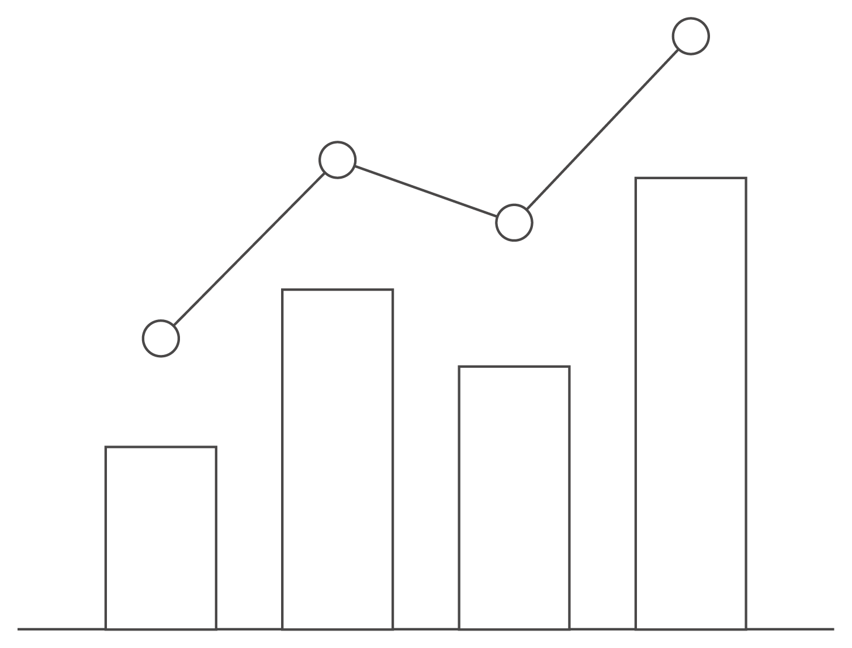


Analytics in MongoDB?
Analytics
?
Create
Read
Update
Delete
Group
Count
Derive Values
Filter
Average
Sort

Slide 4

For Example: US Census Data
Census data from 1990, 2000, 2010
Question:
Which US Division has the fastest growing population density?
We only want to include data for states with more than 1M people
We only want to include divisions larger than 100K square miles
Division = a group of US States
Population density = Area of division/# of people
Data is provided at the state level

Slide 5
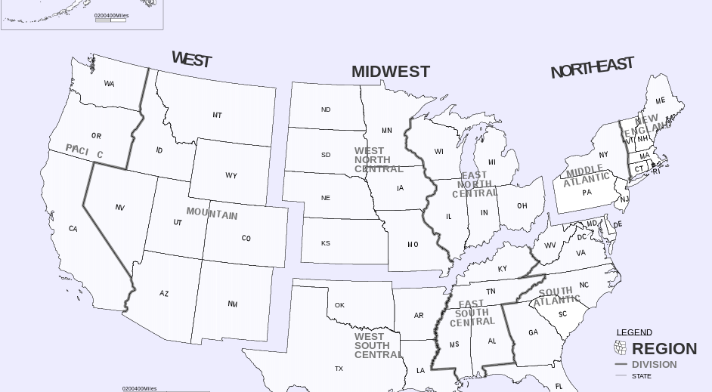
US Regions and Divisions

Slide 6
How would we solve this in SQL?
SELECT GROUP BY HAVING

Slide 7
What About MongoDB?

Slide 8
The Aggregation Framework

Slide 9

What is an Aggregation Pipeline?
A Series of Document Transformations
Executed in stages
Original input is a collection
Output as a cursor or a collection
Rich Library of Functions
Filter, compute, group, and summarize data
Output of one stage sent to input of next
Operations executed in sequential order

Slide 10
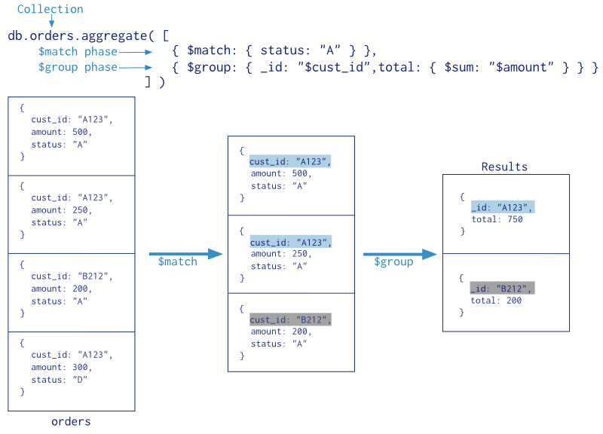
Aggregation Pipeline

Slide 11
Pipeline Operators
• $match
Filter documents
• $project
Reshape documents
• $group
Summarize documents
• $unwind
Expand documents
• $sort
Order documents
• $limit/$skip
Paginate documents
• $redact
Restrict documents
• $geoNear
Proximity sort documents
• $let,$map
Define variables

Slide 12

Aggregation Framework in Action (let’s play with the census data)

Slide 13
MongoDB State Collection
Document For Each State
Name
Region
Division
Census Data For 1990, 2000, 2010
Population
Housing Units
Occupied Housing Units
Census Data is an array with three subdocuments

Slide 14
Document Model
{ "_id" : ObjectId("54e23c7b28099359f5661525"),
"name" : "California",
"region" : "West",
"data" : [
{"totalPop" : 33871648,
"totalHouse" : 12214549,
"occHouse" : 11502870,
"year" : 2000},
{"totalPop" : 37253956,
"totalHouse" : 13680081,
"occHouse" : 12577498,
"year" : 2010},
{"totalPop" : 29760021,
"totalHouse" : 11182882,
"occHouse" : 29008161,
"year" : 1990}
],
…
}

Slide 15
Total US Area
db.cData.aggregate([
{"$group" : {"_id" : null,
"totalArea" : {$sum : "$areaM"},
"avgArea" : {$avg : "$areaM"}}}])

Slide 16

$group
Group documents by value
Field reference, document, constant
Other output fields are computed
$max, $min, $avg, $sum
$addToSet, $push
$first, $last
Processes all data in memory by default

Slide 17
Area By Region
db.cData.aggregate([
{"$group" : {"_id" : "$region",
"totalArea" : {$sum : "$areaM"},
"avgArea" : {$avg : "$areaM"},
"numStates" : {$sum : 1},
"states" : {$push : "$name"}}}
])

Slide 18
Calculating Average State Area By Region
{
state: ”New York",
areaM: 54554,
region: “Northeast"
}
{ $group: {
_id: "$region",
avgArea: {$avg:
”$areaM" }
}}
{
state: ”New Jersey",
areaM: 8722,
region: “Northeast”
}
{
_id: ”Northeast",
avgAreaM: 20146
}
{
state: “California",
areaM: 163694,
region: “West"
}
{
_id: “West",
avgAreaM: 144096
}

Slide 19
Calculating Total Area and State Count
{
state: ”New York",
areaM: 54554,
region: “North East"
}
{ $group: {
_id: "$region",
totArea: {$sum:
”$areaM" },
sCount : {$sum : 1}}}
{
state: ”New Jersey",
areaM: 8722,
region: “North East”
}
{
_id: ”Northeast",
totArea: 308
sCount: 2}
{
state: “California",
area: 163694,
region: “West"
}
{
_id: “West",
totArea: 300,
sCount: 1}

Slide 20
Total US Population By Year
db.cData.aggregate(
[{$unwind : "$data"},
{$group : {"_id" : "$data.year",
"totalPop" : {$sum : "$data.totalPop"}}},
{$sort : {"totalPop" : 1}}
])

Slide 21
$unwind
Operate on an array field
Create documents from array elements
Array replaced by element value
Missing/empty fields → no output
Non-array fields → error
Pipe to $group to aggregate

Slide 22
$unwind
{
state: ”New York",
census: [1990, 2000,
2010]
}
{ $unwind: $census }
{ state: “New York,
census: 1990}
{
state: ”New Jersey",
census: [1990, 2000]
}
{ state: “New York,
census: 2000}
{
state: “California",
census: [1980, 1990,
2000, 2010]
}
{ state: “New York,
census: 2010}
{ state: “New Jersey,
census: 1990}
{
state: ”Delaware",
census: [1990, 2000]
}
{ state: “New Jersey,
census: 2000}
…

Slide 23
Southern State Population By Year
db.cData.aggregate(
[{$match : {"region" : "South"}},
{$unwind : "$data"},
{$group : {"_id" : "$data.year", "totalPop” : {"$sum” : "$data.totalPop"}}}])

Slide 24


$match
Filter documents
Uses existing query syntax
No $where (server side Javascript)

Slide 25
$match
{
state: ”New York",
areaM: 218,
region: “Northeast"
}
{ $match:
{ “region” : “West” }
}
{
state: ”Oregon",
areaM: 245,
region: “West”
}
{
state: ”Oregon",
areaM: 245,
region: “West”
}
{
state: “California",
area: 300,
region: “West"
}
{
state: “California",
area: 300,
region: “West"
}

Slide 26
Population Delta By State from 1990 to 2010
db.cData.aggregate(
[{$unwind : "$data"},
{$sort : {"data.year" : 1}}, {$group : {"_id" : "$name", "pop1990" : {"$first" : "$data.totalPop"}, "pop2010" : {"$last" : "$data.totalPop"}}}, {$project : {"_id" : 0, "name" : "$_id", "delta" : {"$subtract" :
["$pop2010", "$pop1990"]}, "pop1990" : 1,
"pop2010” : 1}
}]
)

Slide 27
Population Delta By State from 1990 to 2010
db.cData.aggregate(
[{$unwind : "$data"},
{$sort : {"data.year" : 1}}, {$group : {"_id" : "$name", "pop1990" : {"$first" : "$data.totalPop"}, "pop2010" : {"$last" : "$data.totalPop"}}}, {$project : {"_id" : 0, "name" : "$_id", "delta" : {"$subtract" :
["$pop2010", "$pop1990"]}, "pop1990" : 1,
"pop2010” : 1}
}]
)

Slide 28

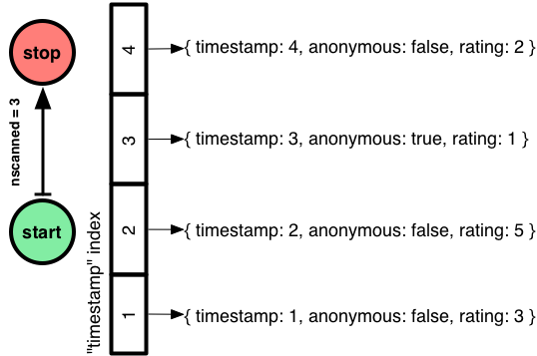
$sort, $limit, $skip
Sort documents by one or more fields
Same order syntax as cursors
Waits for earlier pipeline operator to return
In-memory unless early and indexed
Limit and skip follow cursor behavior

Slide 29
Population Delta By State from 1990 to 2010
db.cData.aggregate(
[{$unwind : "$data"},
{$sort : {"data.year" : 1}}, {$group : {"_id" : "$name", "pop1990" : {"$first" : "$data.totalPop"}, "pop2010" : {"$last" : "$data.totalPop"}}}, {$project : {"_id" : 0, "name" : "$_id", "delta" : {"$subtract" :
["$pop2010", "$pop1990"]}, "pop1990" : 1,
"pop2010” : 1}
}]
)

Slide 30
$first, $last
Collection operations like $push and $addToSet
Must be used in $group
$first and $last determined by document order
Typically used with $sort to ensure ordering is known

Slide 31
Population Delta By State from 1990 to 2010
db.cData.aggregate(
[{$unwind : "$data"},
{$sort : {"data.year" : 1}}, {$group : {"_id" : "$name", "pop1990" : {"$first" : "$data.totalPop"}, "pop2010" : {"$last" : "$data.totalPop"}}}, {$project : {"_id" : 0, "name" : "$_id", "delta" : {"$subtract" :
["$pop2010", "$pop1990"]}, "pop1990" : 1,
"pop2010” : 1}
}]
)

Slide 32

$project
Reshape Documents
Include, exclude or rename fields
Compute field values
Create sub-document fields

Slide 33
Including and Excluding Fields
{
"_id" : "Virginia”,
"pop1990" : 453588,
"pop2010" : 3725789
}
{ $project:
{ “_id” : 0,
“pop1990” : 1,
“pop2010” : 1
}
{
"_id" : "South Dakota",
"pop1990" : 453588,
"pop2010" : 3725789
}
{
"pop1990" : 453588,
"pop2010" : 3725789
}
{
"pop1990" : 453588,
"pop2010" : 3725789
}

Slide 34
Renaming and Computing Fields
{
"_id" : "Virginia”,
"pop1990" : 6187358,
"pop2010" : 8001024
}
{ $project:
{ “_id” : 0,
“pop1990” : 0,
“pop2010” : 0,
“name” : “$_id”,
"delta" :
{"$subtract" :
["$pop2010",
"$pop1990"]}}
}
{
"_id" : "South Dakota",
"pop1990" : 696004,
"pop2010" : 814180
}
{
”name" : “Virginia”,
”delta" : 1813666
}
{
”name" : “South Dakota”,
”delta" : 118176
}

Slide 35
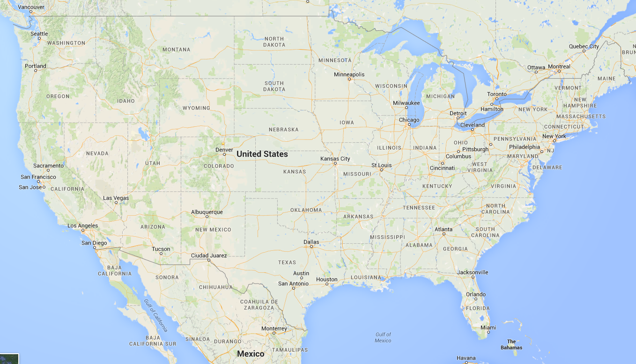
Compare number of people living within 500KM of Memphis, TN in 1990, 2000, 2010

Slide 36
Compare number of people living within 500KM of Memphis, TN in 1990, 2000, 2010
db.cData.aggregate([
{$geoNear : {
"near" : {"type" : "Point", "coordinates" : [90, 35]},
“distanceField” : "dist.calculated",
“maxDistance” : 500000,
“includeLocs” : "dist.location",
“spherical” : true }},
{$unwind : "$data"},
{$group : {"_id" : "$data.year",
"totalPop" : {"$sum" : "$data.totalPop"},
"states" : {"$addToSet" : "$name"}}},
{$sort : {"_id" : 1}}
])

Slide 37

$geoNear
Order/Filter Documents by Location
Requires a geospatial index
Output includes physical distance
Must be first aggregation stage

Slide 38
$geoNear
{
"_id" : "Virginia”,
"pop1990" : 6187358,
"pop2010" : 8001024,
“center” :
{“type” : “Point”,
“coordinates” :
[78.6, 37.5]}
}
{$geoNear : {
"near”: {"type”: "Point",
"coordinates”:
[90, 35]},
maxDistance : 500000,
spherical : true }}
{
"_id" : ”Tennessee",
"pop1990" : 4877185,
"pop2010" : 6346105,
“center” :
{“type” : “Point”,
“coordinates” :
[86.6, 37.8]}
}
{
"_id" : ”Tennessee",
"pop1990" : 4877185,
"pop2010" : 6346105,
“center” :
{“type” : “Point”,
“coordinates” :
[86.6, 37.8]}
}

Slide 39
What if I want to save the results to a collection?
db.cData.aggregate([
{$geoNear : {
"near" : {"type" : "Point", "coordinates" : [90, 35]},
“distanceField” : "dist.calculated",
“maxDistance” : 500000,
“includeLocs” : "dist.location",
“spherical” : true }},
{$unwind : "$data"},
{$group : {"_id" : "$data.year",
"totalPop" : {"$sum" : "$data.totalPop"},
"states" : {"$addToSet" : "$name"}}},
{$sort : {"_id" : 1}},
{$out : “peopleNearMemphis”}
])

Slide 40
$out
db.cData.aggregate([<pipeline stages>,
{“$out” : “resultsCollection”}])
Save aggregation results to a new collection
New aggregation uses:
Transform documents - ETL

Slide 41
Back To The Original Question
Which US Division has the fastest growing population density?
We only want to include states with more than 1M people
We only want to include divisions larger than 100K square miles

Slide 42
Division with Fastest Growing Pop Density
db.cData.aggregate(
[{$match : {"data.totalPop" : {"$gt" : 1000000}}},
{$unwind : "$data"},
{$sort : {"data.year" : 1}},
{$group : {"_id" : "$name",
"pop1990" : {"$first" : "$data.totalPop"},
"pop2010" : {"$last" : "$data.totalPop"}, "areaM" : {"$first" : "$areaM"},
"division" : {"$first" : "$division"}}},
{$group : {"_id" : "$division",
"totalPop1990" : {"$sum" : "$pop1990"},
"totalPop2010" : {"$sum" : "$pop2010"},
"totalAreaM" : {"$sum" : "$areaM"}}},
{$match : {"totalAreaM" : {"$gt" : 100000}}},
{$project : {"_id" : 0,
"division" : "$_id",
"density1990" : {"$divide" : ["$totalPop1990", "$totalAreaM"]},
"density2010" : {"$divide" : ["$totalPop2010", "$totalAreaM"]},
"denDelta" : {"$subtract" : [{"$divide" : ["$totalPop2010",
"$totalAreaM"]},
{"$divide" : ["$totalPop1990”,
"$totalAreaM"]}]},
"totalAreaM" : 1,
"totalPop1990" : 1,
"totalPop2010" : 1}},
{$sort : {"denDelta" : -1}}])

Slide 43
Aggregate Options

Slide 44
Aggregate options
db.cData.aggregate([<pipeline stages>],
{‘explain’ : false
'allowDiskUse' : true,
'cursor' : {'batchSize' : 5}})
explain – similar to find().explain()
allowDiskUse – enable use of disk to store intermediate results
cursor – specify the size of the initial result

Slide 45
Aggregation and Sharding

Slide 46
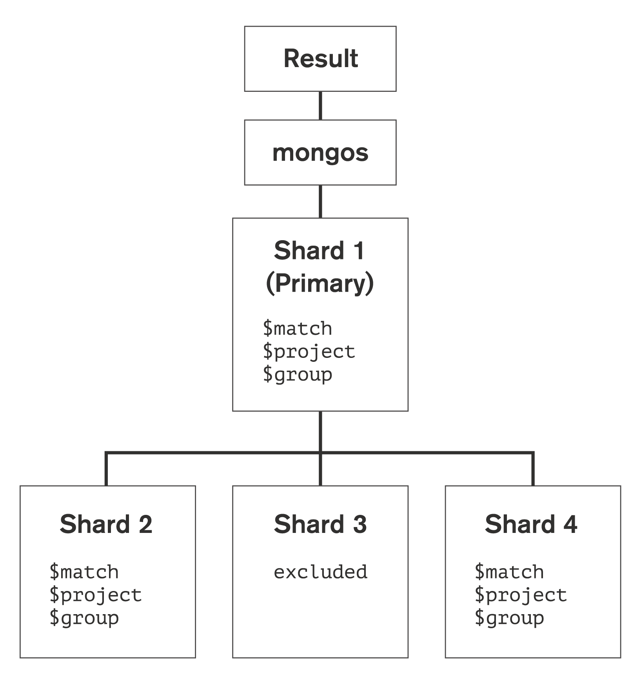
Sharding
Workload split between shards
Shards execute pipeline up to a point
Primary shard merges cursors and continues processing*
Use explain to analyze pipeline split
Early $match may excuse shards
Potential CPU and memory implications for primary shard host
*Prior to v2.6 second stage pipeline processing was
done by mongos

Slide 47
Summary

Slide 48

Analytics in MongoDB?
Analytics
Create
Read
Update
Deletet
?
Group
Count
Derive Values
Filter
Average
Sort
YES!

Slide 49
Framework Use Cases
Basic aggregation queries
Ad-hoc reporting
Real-time analytics
Visualizing and reshaping data

Slide 50
Questions?
shannon@mongodb.com

